Slide 1

No Cameraman Left Behind
Jeffrey Li
Sindhura Mente
Amar Mohanty
Sriya Reddi

Slide 2
Presentation Outline
01
02
03
04
Problem & Motivation
Approach
Live Demo
Results & Discussion

Slide 3
Problem & Motivation

Slide 4
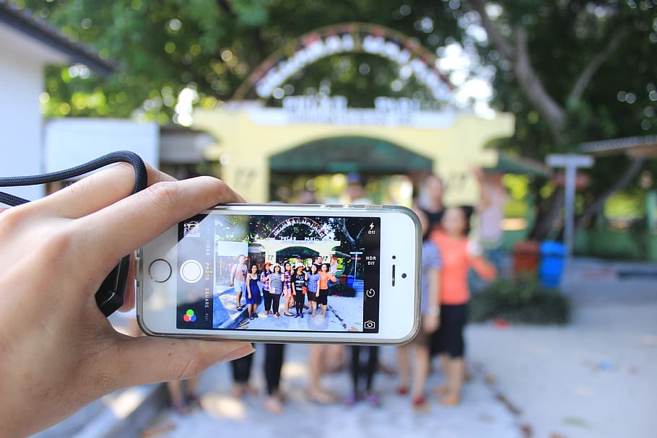
Picture the Following…
Notes:
You are with your friends, and one person takes a picture of everyone else but no one is available to take a picture with the cameraman included in the group photo. There is also no place to set up a self timer at the right angle for your photo, so you’re stuck with one person always being left out of the photo.
Our product will take two photos: one of the group, or a single person, and one of the cameraman, and will automatically insert the cameraman into the group photo. All we require from the user: 2 photos

Slide 5
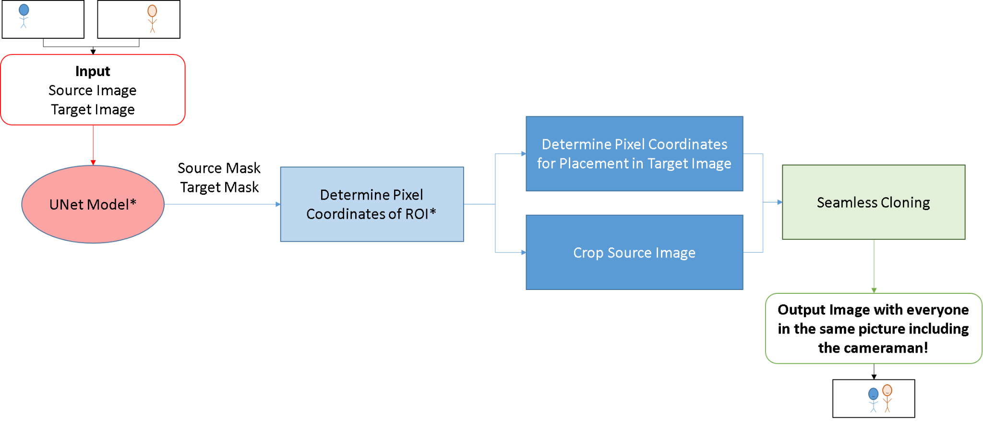
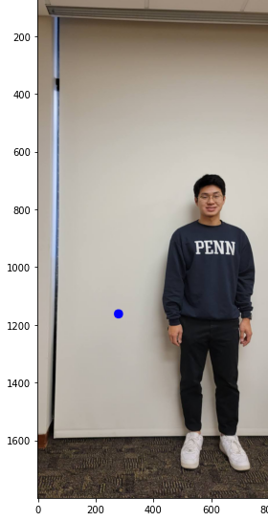
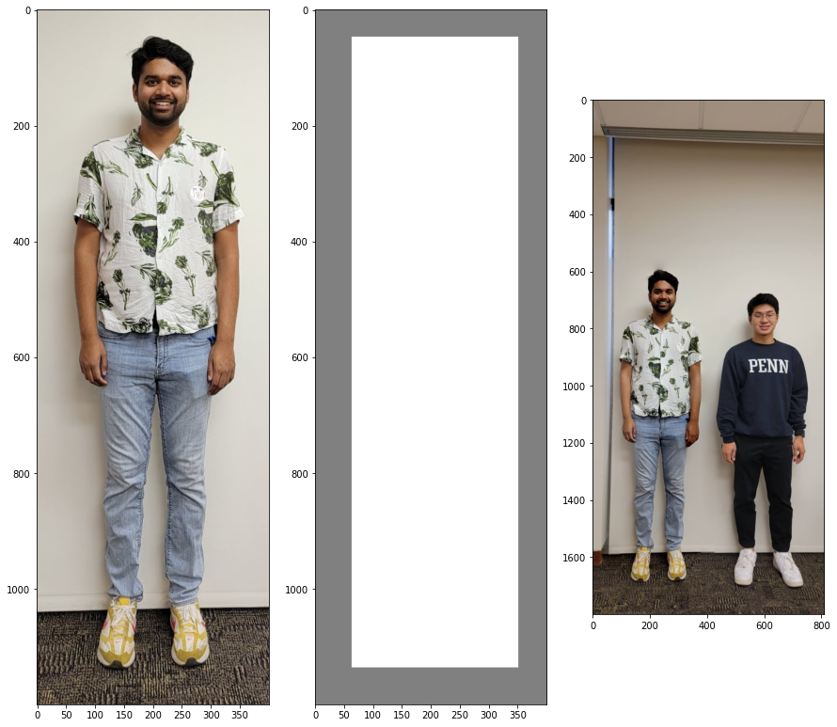
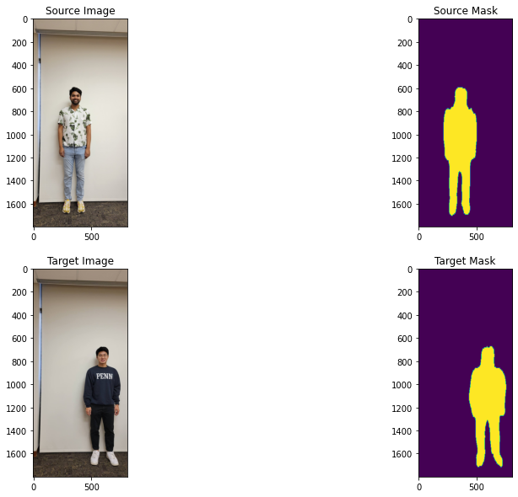
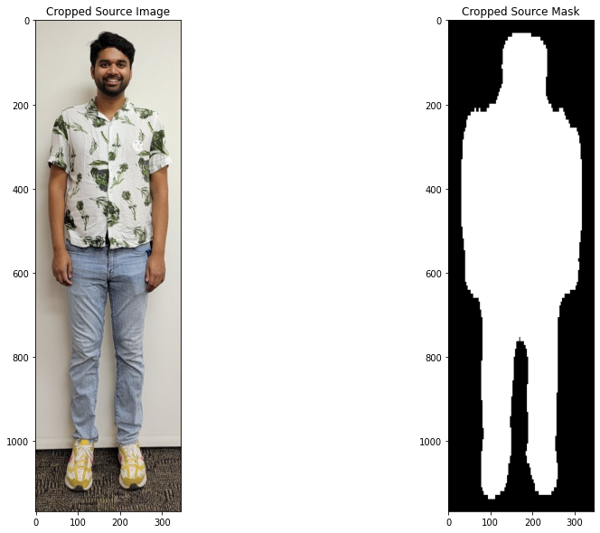
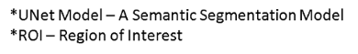
Approach

Slide 6
Time for a Live Demo!

Slide 7
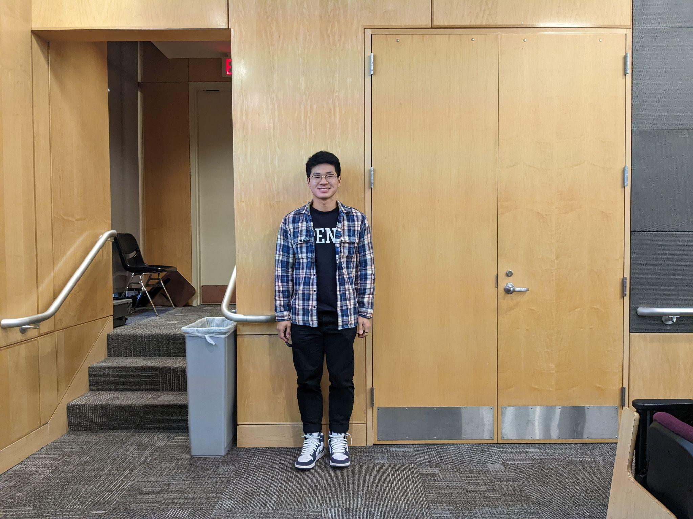
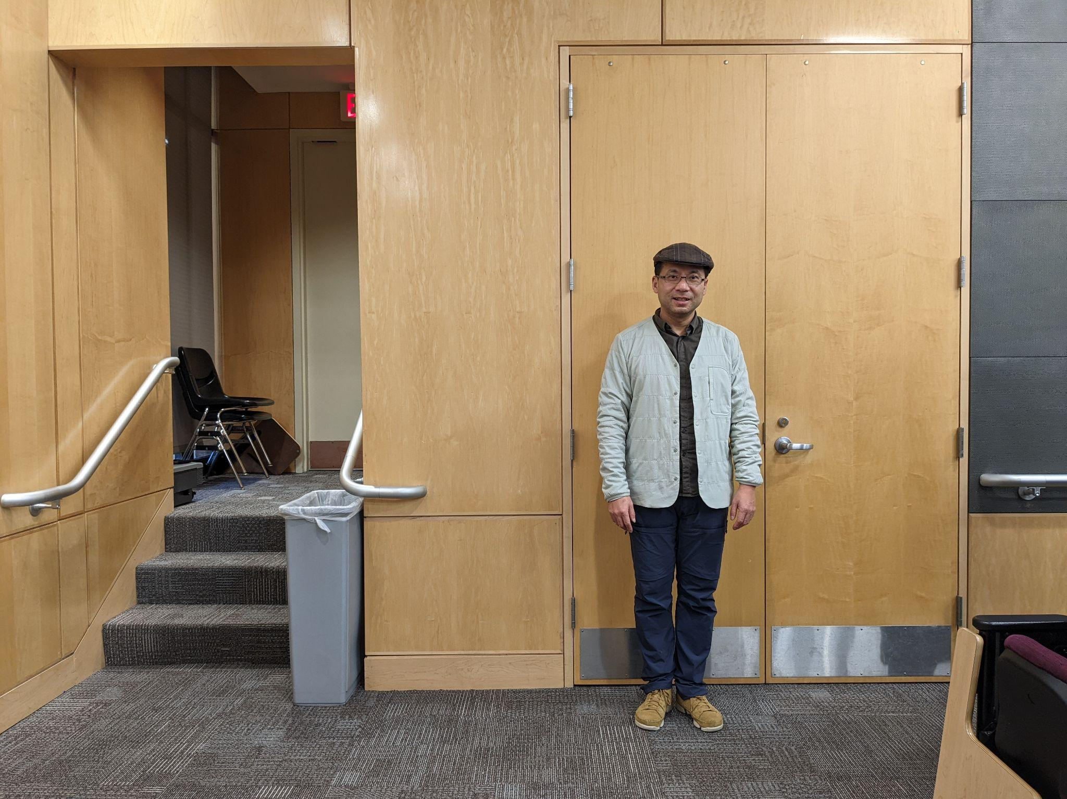
Live Demo Source and Target Image

Slide 8
Results

Slide 9
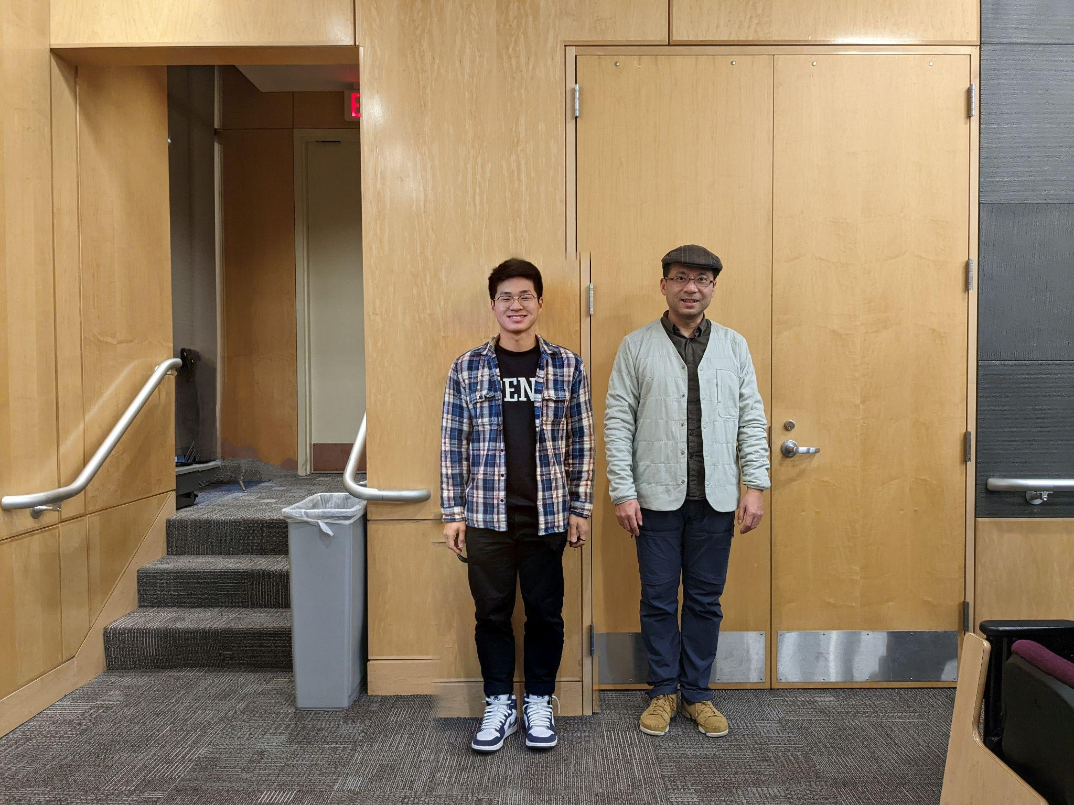
Live Demo Results

Slide 10
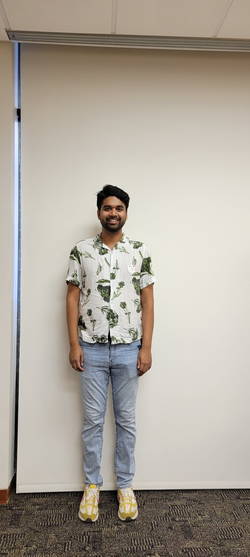
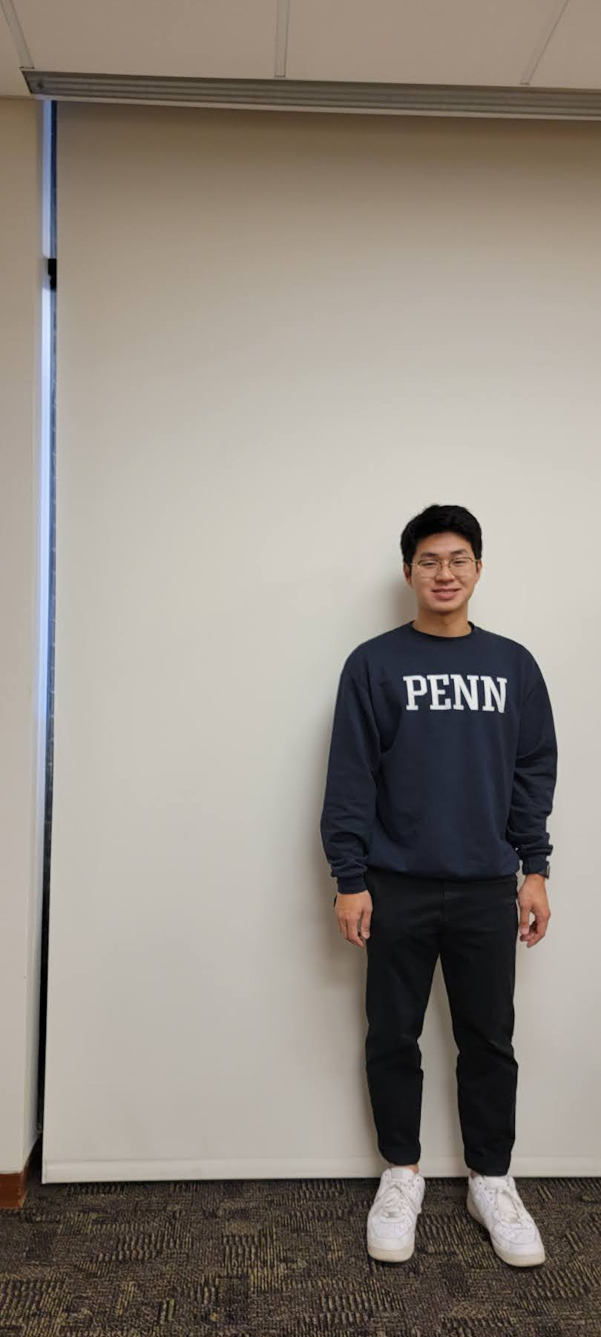
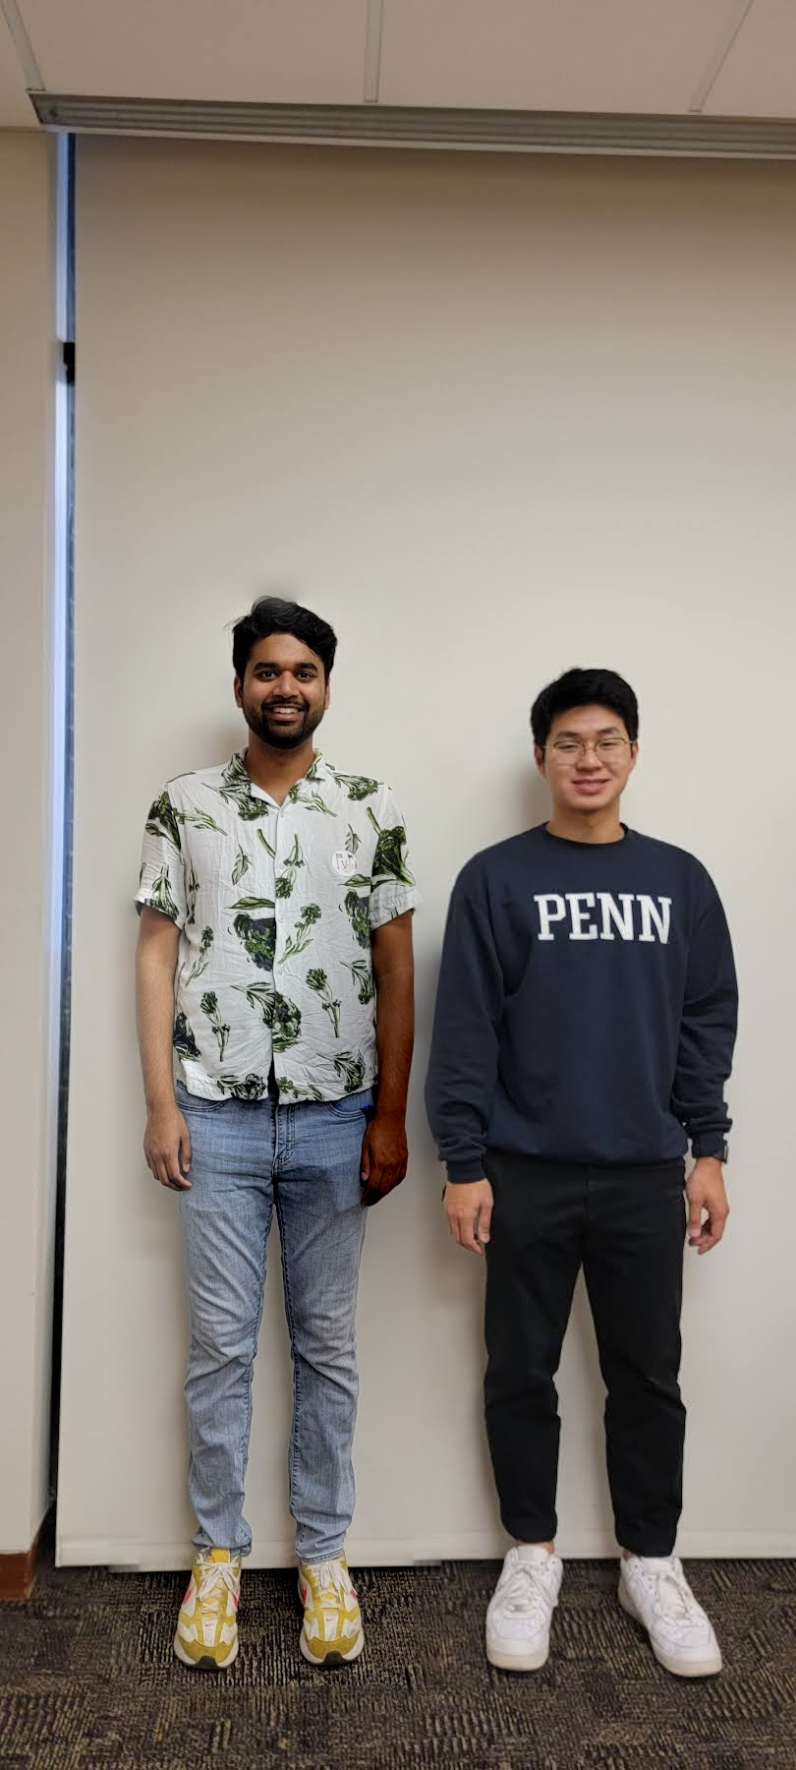

Slide 12
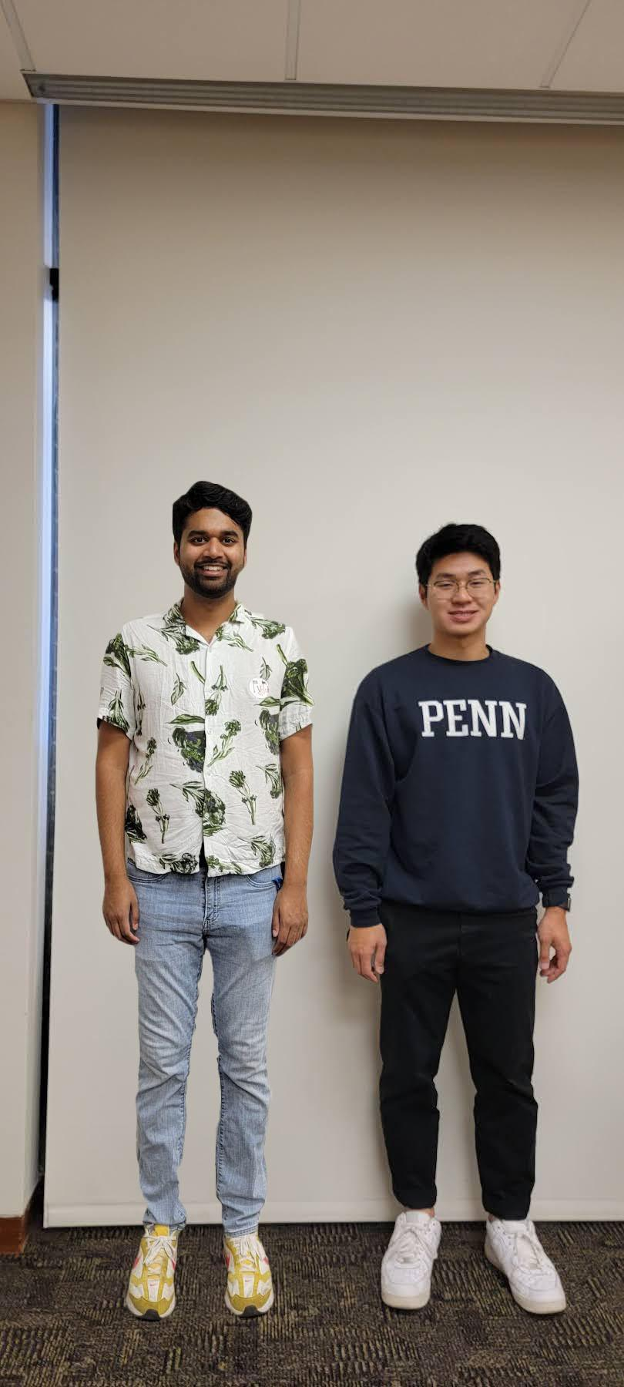
Which one is the Photoshop result?

Slide 13
Comparison to Adobe Photoshop
Our Product
Photoshop

Slide 14
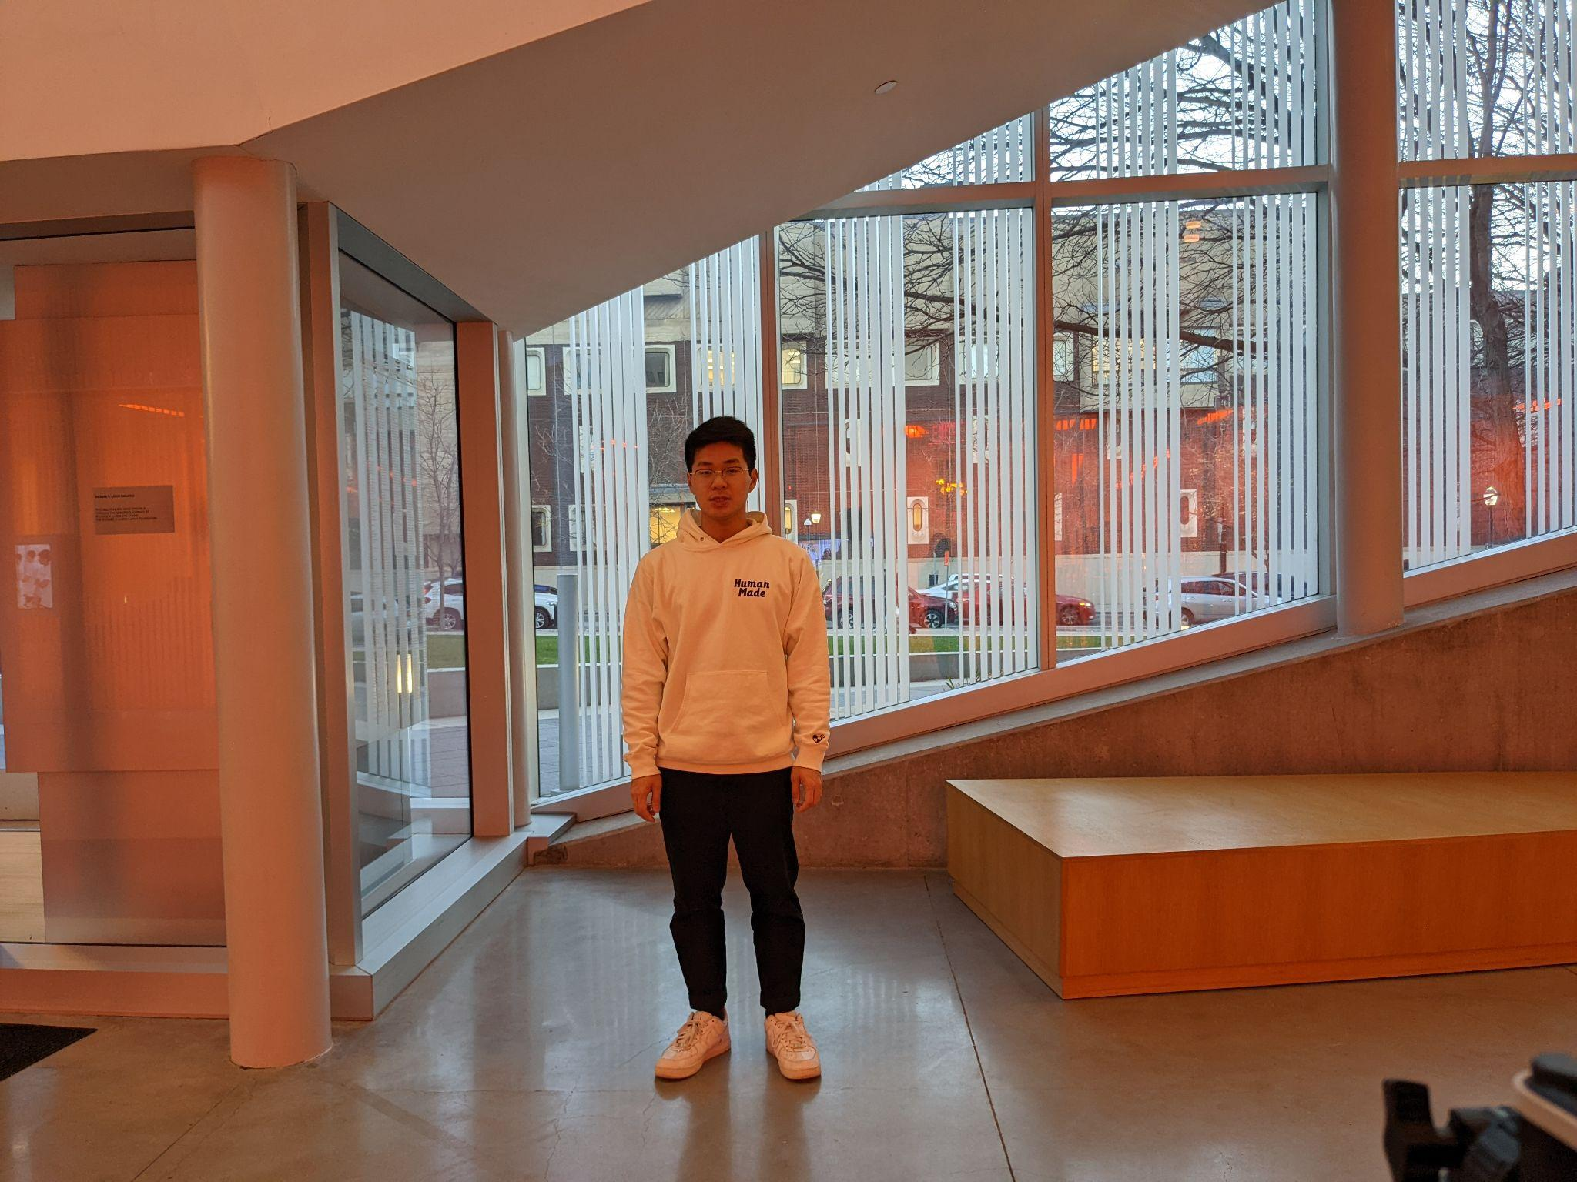
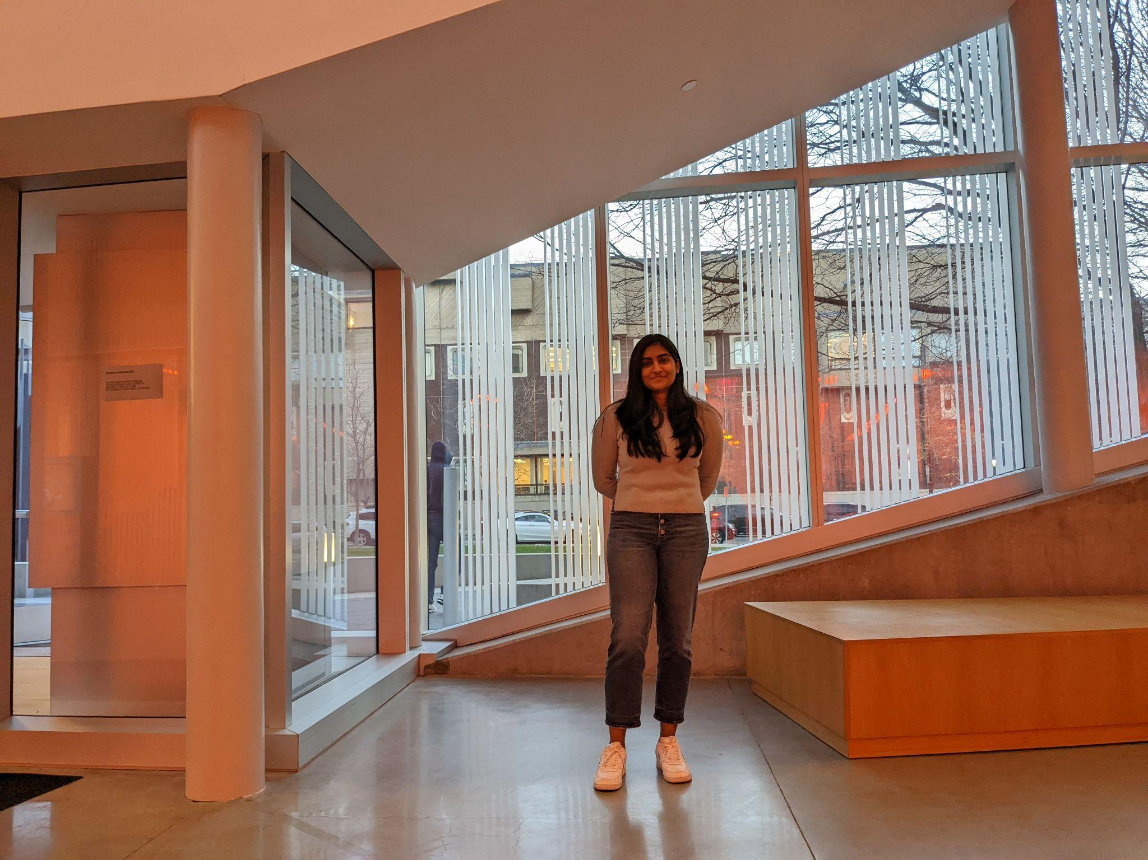
Complex Background/Lighting

Slide 15
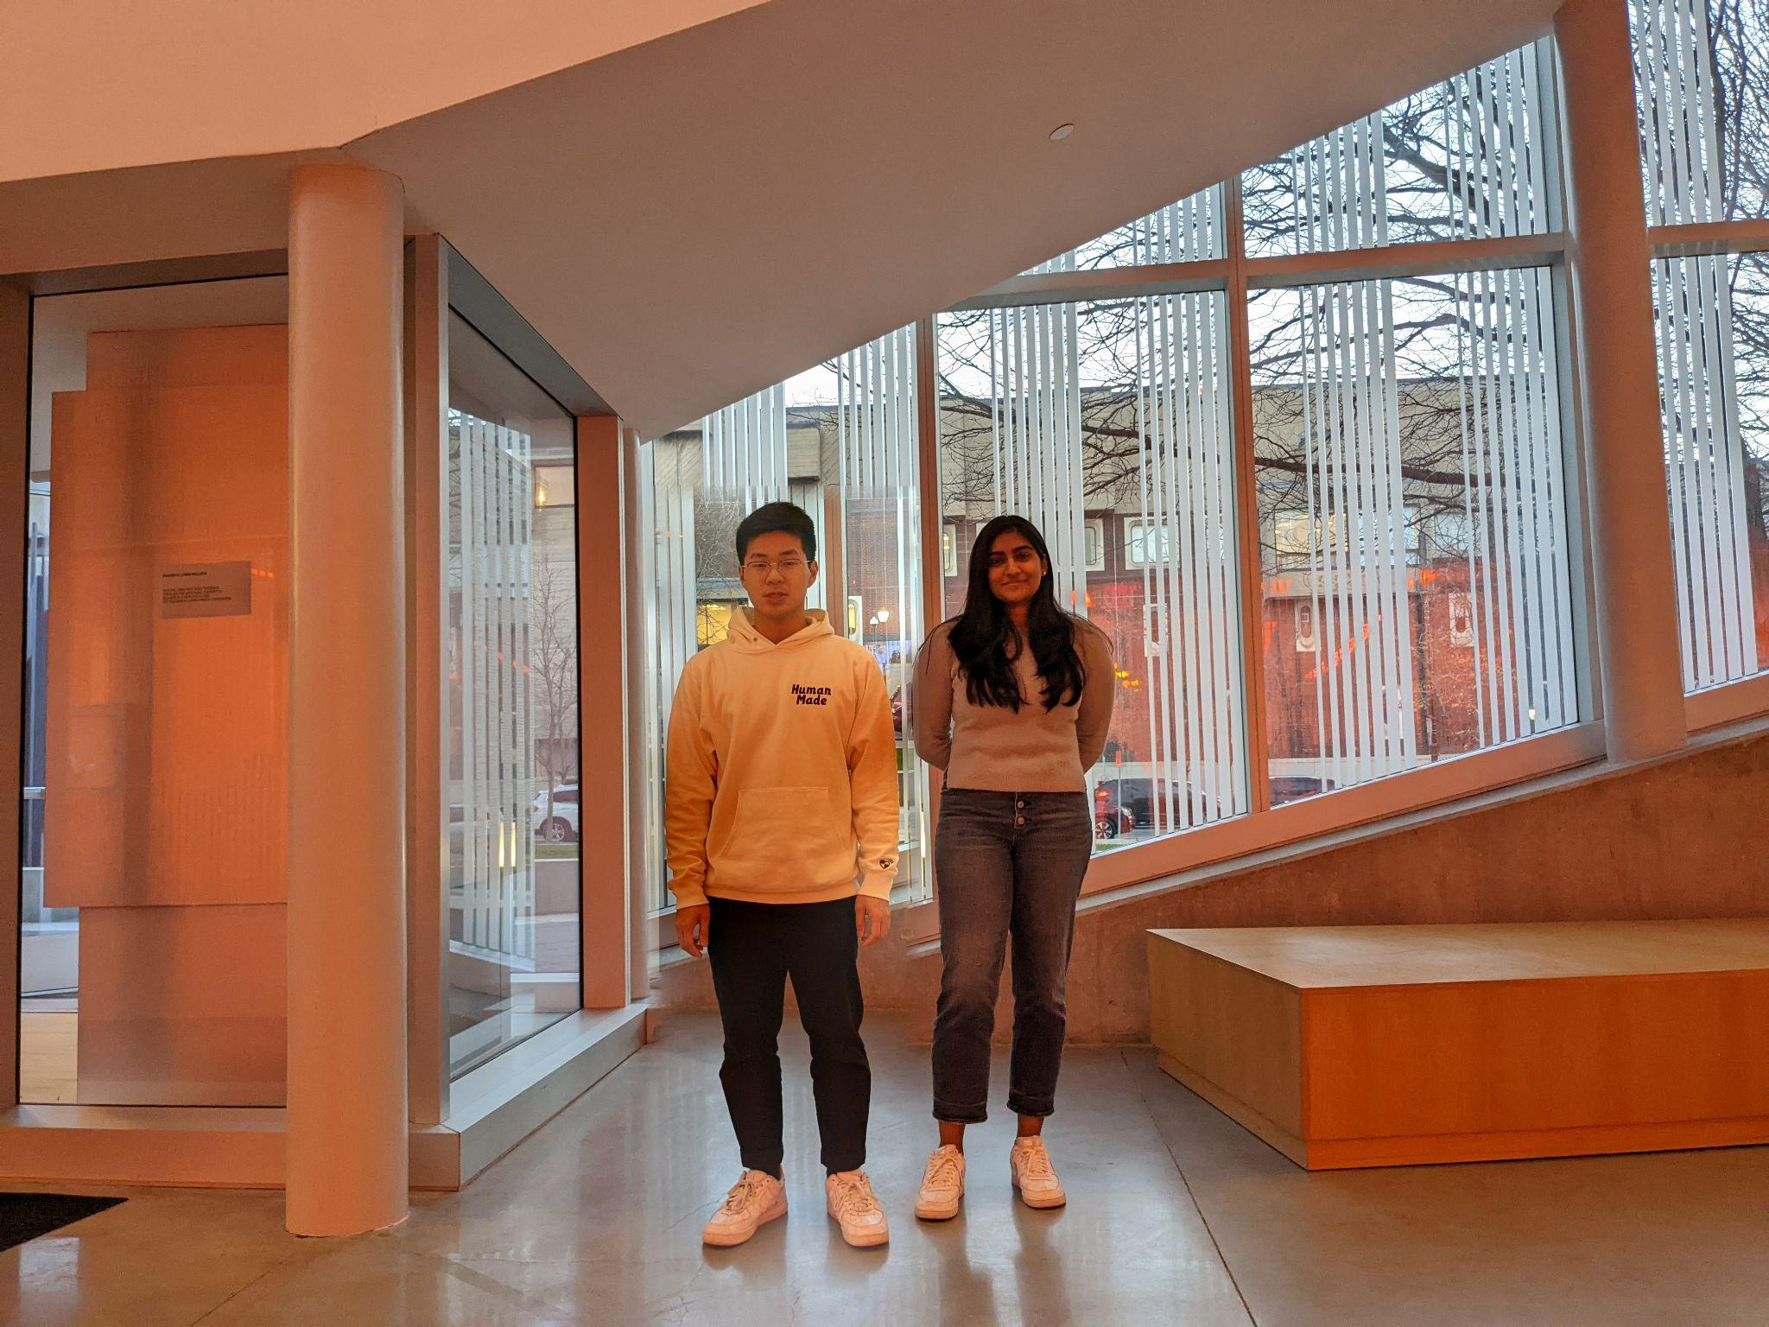
Complex Background/Lighting Cont…

Slide 16
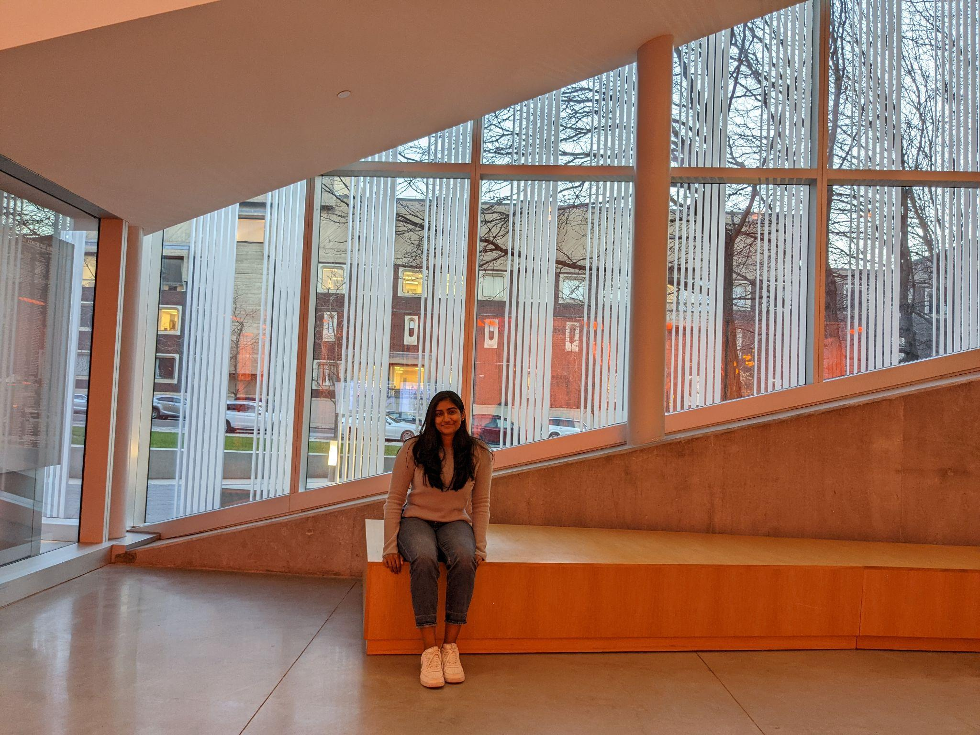
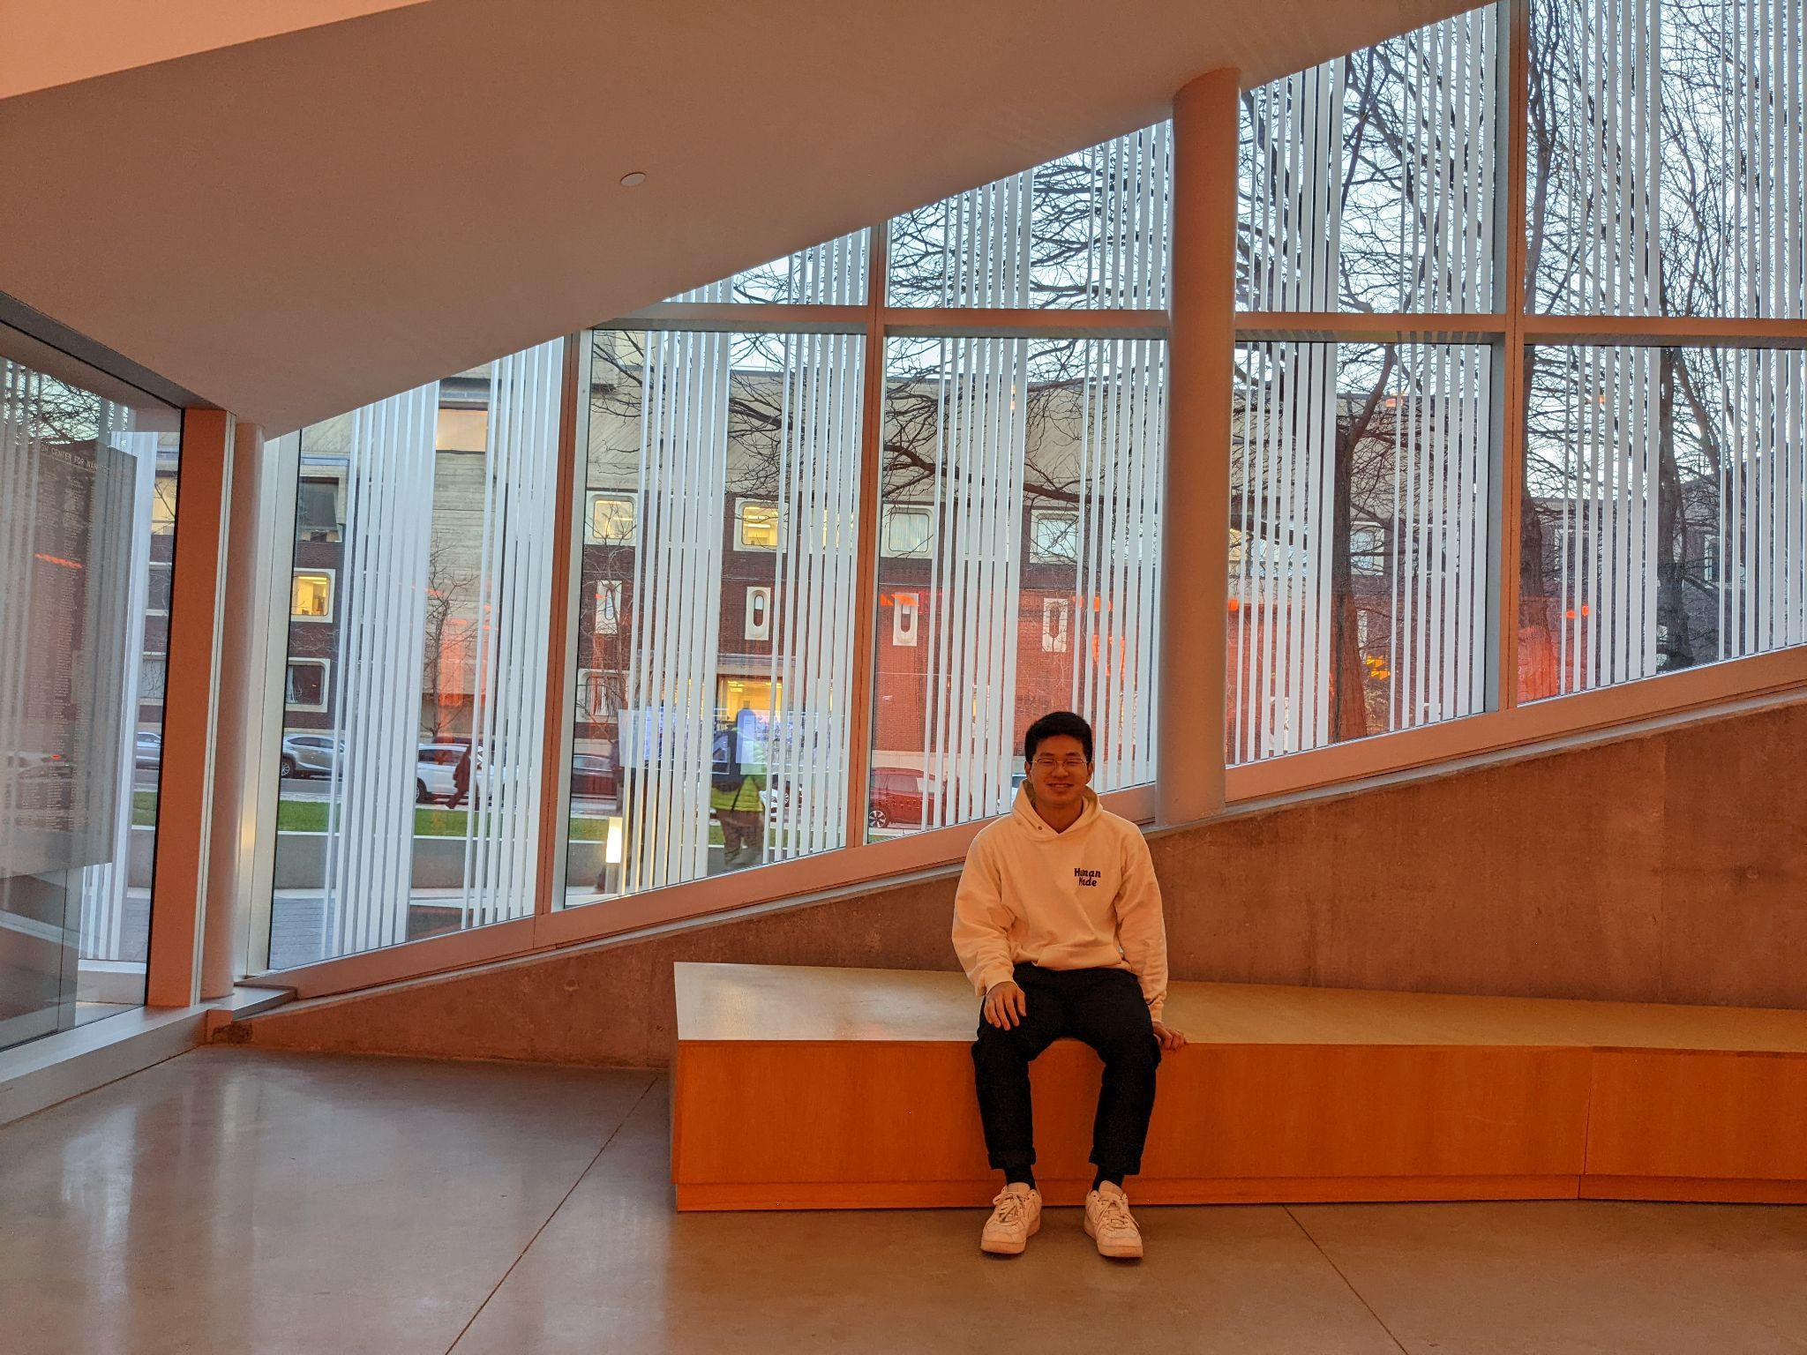
Sitting

Slide 17
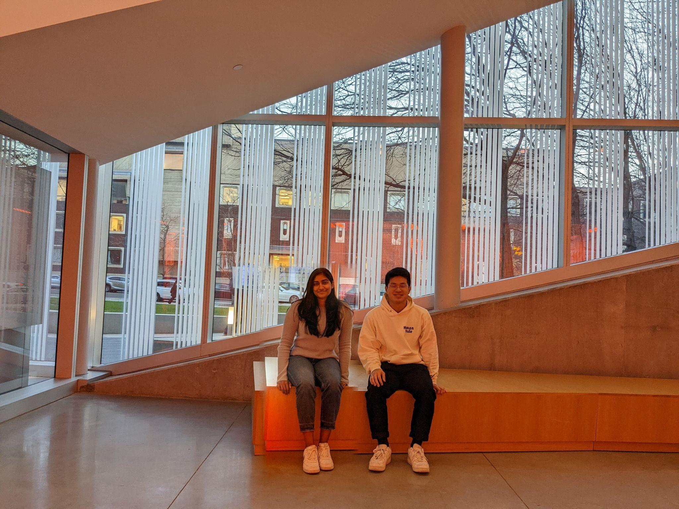
Sitting Cont.

Slide 18
Conclusion & Future Plans

Slide 19
Conclusion
We developed a working MVP that allowed users to take pictures of each other and combine it so that it looked like they are together
Next Steps:
Develop more robustness with dealing with translation, rotation, and resizing between the two pictures
Group Pictures - More advance image segmentation model and new calculation for where to place the person
Photo App

Slide 20
Thank You!!!
Prof. Shi
& the TAs

Slide 21
Questions?

Slide 22
Approach

